Slide 1

AASD 4016 - Full stack Data Science Systems
AASD 4017 - Presenting Data Science-driven Solutions
Product-Market Research Company - Amazon Review Insights
Created & Presented by (Group 6):
Jai Vigneshwar Aiyyappan (101448497)
Vignesh Baskaran(101435847)
Ali Guneysel (101486766)
Madhoumithaa Veerasethu (101471815)

Slide 2
About the Company
We are a product research company whose aim is to provide insights about how a seller's product is perceived by their consumers.
To begin with, we have created a website that provides insights to sellers on Amazon. We are planning to expand this to include other e-commerce platforms in the future.
Primary Audience: Product Sellers
Secondary Audience : Product Users/Consumers
1. Search Engine Ranking: A one-star increase in a product's rating can lead to a 5-9% increase in revenue.
2. Customer Engagement: Products with reviews generate 12.5 times more page views than those without.
3. Time Saving: Access to comprehensive reviews saves up to 40% of decision-making time.
4. Trust and Conversion: 93% of consumers trust online reviews, with positive feedback enhancing credibility.

Slide 3
Why? - Hook
Total Users in Amazon 2.4 billion + 9.7 million
Total Sellers – 9.7 million
Current Active Sellers – 1.9 million
Opportunities:
No Marketing budget needed. We can acquire existing seller base.
Future Acquistion opportunities by Amazon.
It can be a SAAS Solution for ecommerce companies.

Slide 4
Proposed Solution - MVP
Our solution will automate the extraction of meaningful insights from product reviews
Key features include
Action items
Pros and Cons for each feature of the product
Sentiment analysis over time.
Visualizations such as word clouds and rating trends

Slide 5
Literature Review
Helium 10, AMZScout, and Sellics are softwares tailored specifically for Amazon sellers. These tools offer a wide range of features aimed at optimizing various aspects of selling on the Amazon marketplace. Key functionalities include product research, keyword research, listing optimization, and sales estimation. Additionally, they provide review analysis tools to help sellers understand customer feedback, monitor reviews, and make data-driven decisions to improve their products and enhance their overall performance on Amazon.
Drawbacks:
Complexity
Seller-Centric Focus
Paid features
Benefits of Our Solution:
Condensed Insights
Feature-Based Summaries
User-Centric and Seller-Centric Focus

Slide 6
Pricing Options
Primary Audience - Sellers:
First 5 product research reports are free
Preliminary research reports require a nominal fee of $1.99/report
Detailed research reports for a fee of $4.99/report
Subscription based membership type will be added for sellers.
Secondary Audience – Customers / Users:
Unpaid, with a daily product limit of 3 per customer
Will be receiving income from ads.

Slide 7
Benefits
Primary Audience - Sellers:
Increased Sales and Conversions
Data driven Insights
Customer Audience - Customers:
Informed Decision Making (competitive analysis)
Time Saving
For us:
Monetization opportunities
Partnership opportunities

Slide 8
Risks
Legal Concerns
Data Privacy issues
Dependency on Amazon/other E-commerce platforms
Competitive Landscape
Technical issues

Slide 9
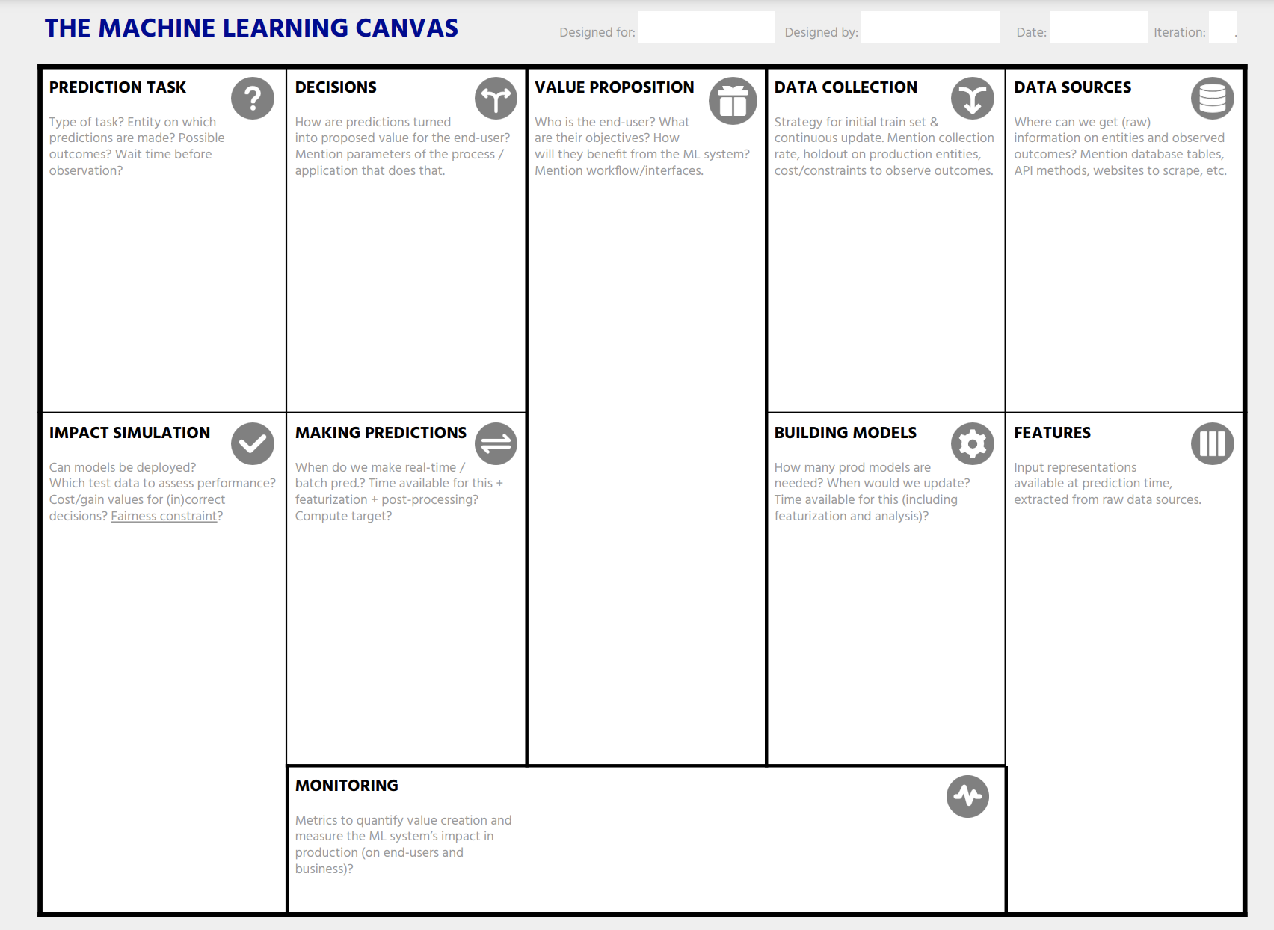
ML Canvas
Summarizer
Sentiment Prediction
Feature Scoring
Recommendation
Fetch product URL from the user
Amazon.com - product and reviews page
Reviews
Our tool takes the input features and provides the summarization and action times using LLMs
Amazon Sellers: People whose products are being sold on the website
Insights and Action items
From the URL get the Product Title, Image, Overall rating, Final price, Description, Features
Title, Rating, Date of each review
MongoDB has detials of Reviews Product_Details ActionItems Summary
Pros and Cons
Reviews Summarizer
Trends in rating
Frequently used words
Approx. few minutes
Collection rate – for every search initiated by user
Constraints – maximum 100 reviews per rating
Amazon Users: People who browse amazon to buy products.
Time saving, Informed decision making, Streamlined Research
4 models
Zero shot classification model - "Recognai/zeroshot_selectra_medium"
Sentiment Analysis model - "cardiffnlp/twitter-roberta-base-sentiment-latest"
Language model – Mistral, gpt-3.5-turbo
Product Title, Image, Overall rating, Final price, Description, Features
Title, Rating, Date of each review,
List of Reviews
Our tool is real time and takes the URL from the user and provides the outputs within few minutes
User Satisfaction
Processing Time
Action Item Relevance
Summarization Accuracy
Resource Utilization
Scalability

Slide 10
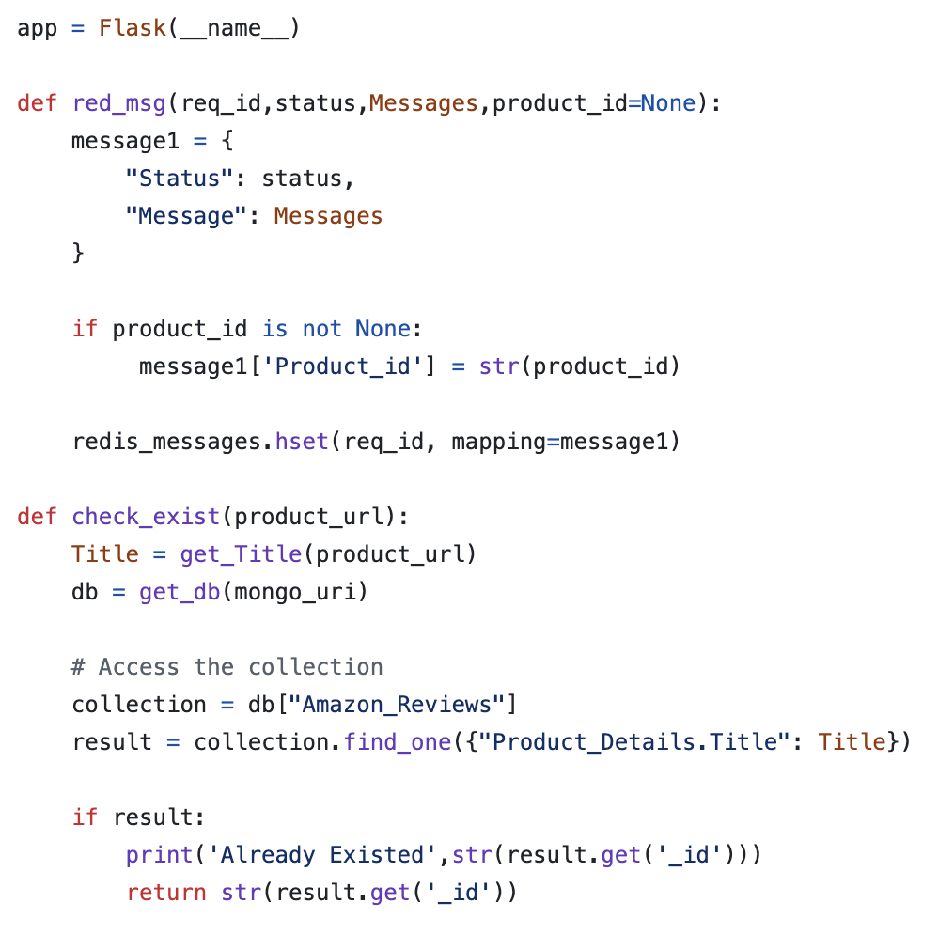
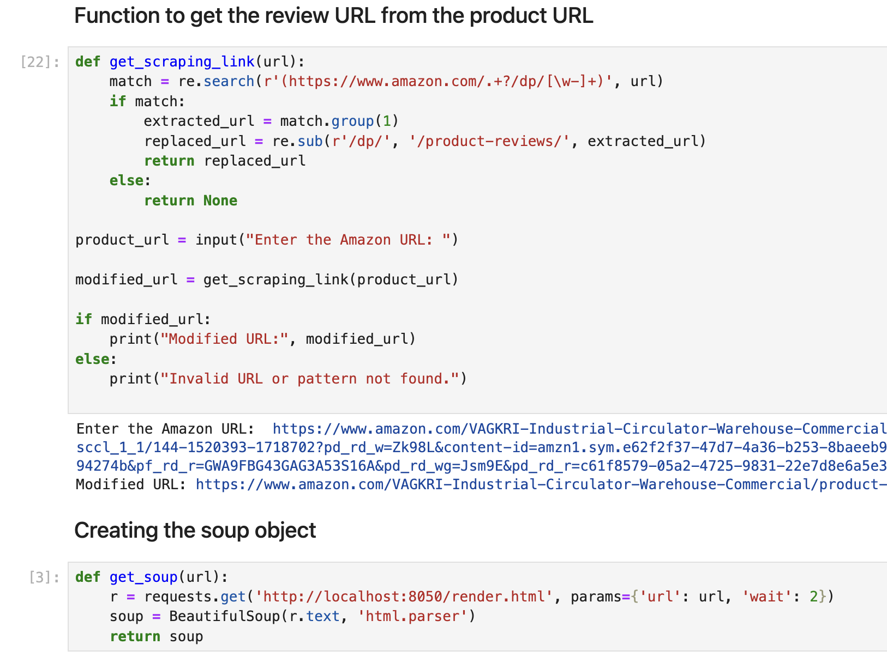
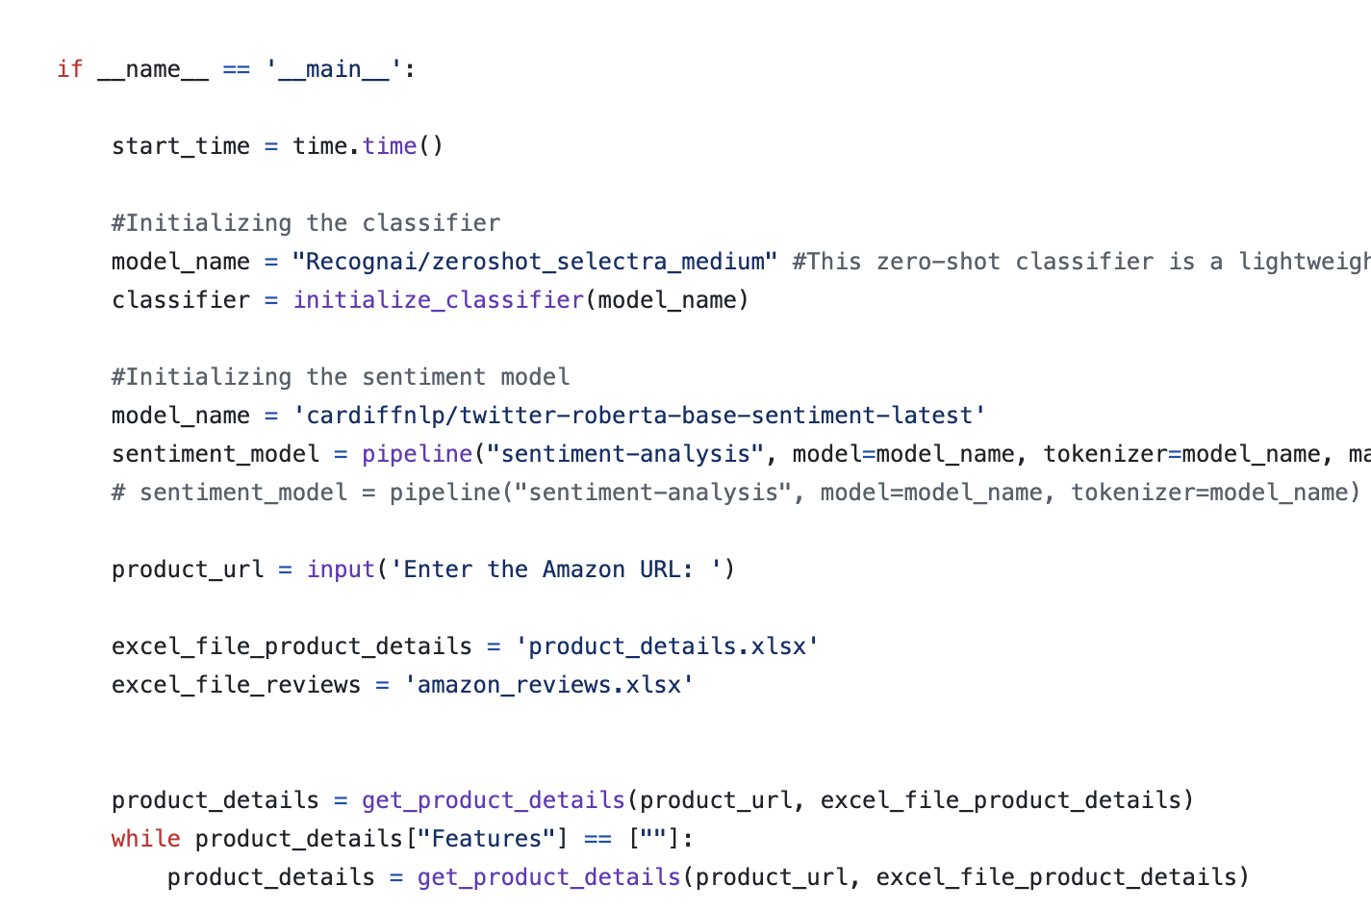
Model Deployment
Notebook to Script
Script to Flask

Slide 11
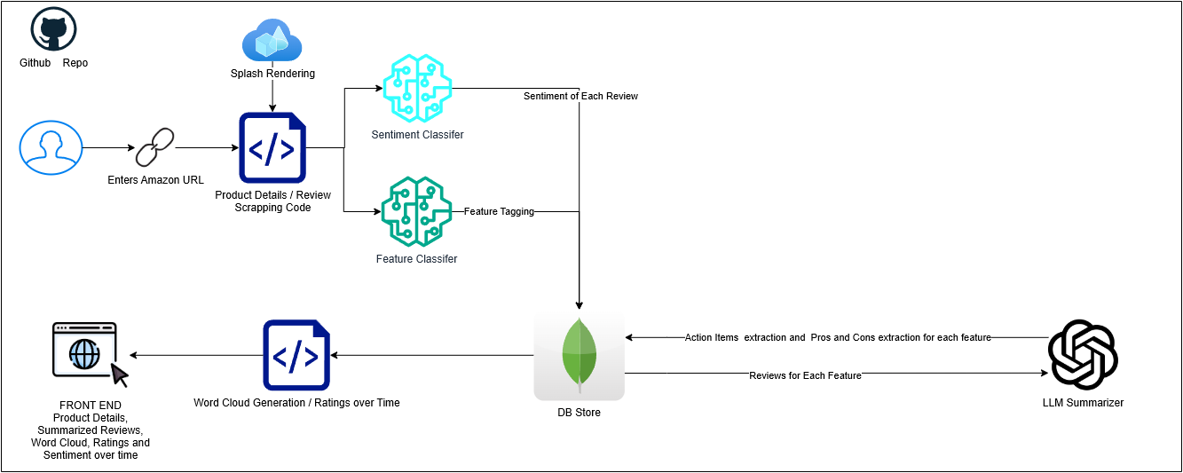
Dataflow

Slide 12
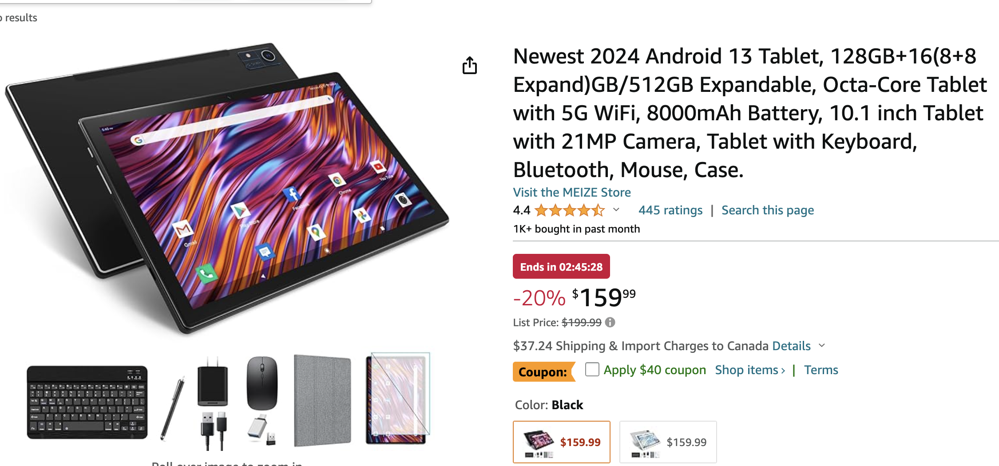
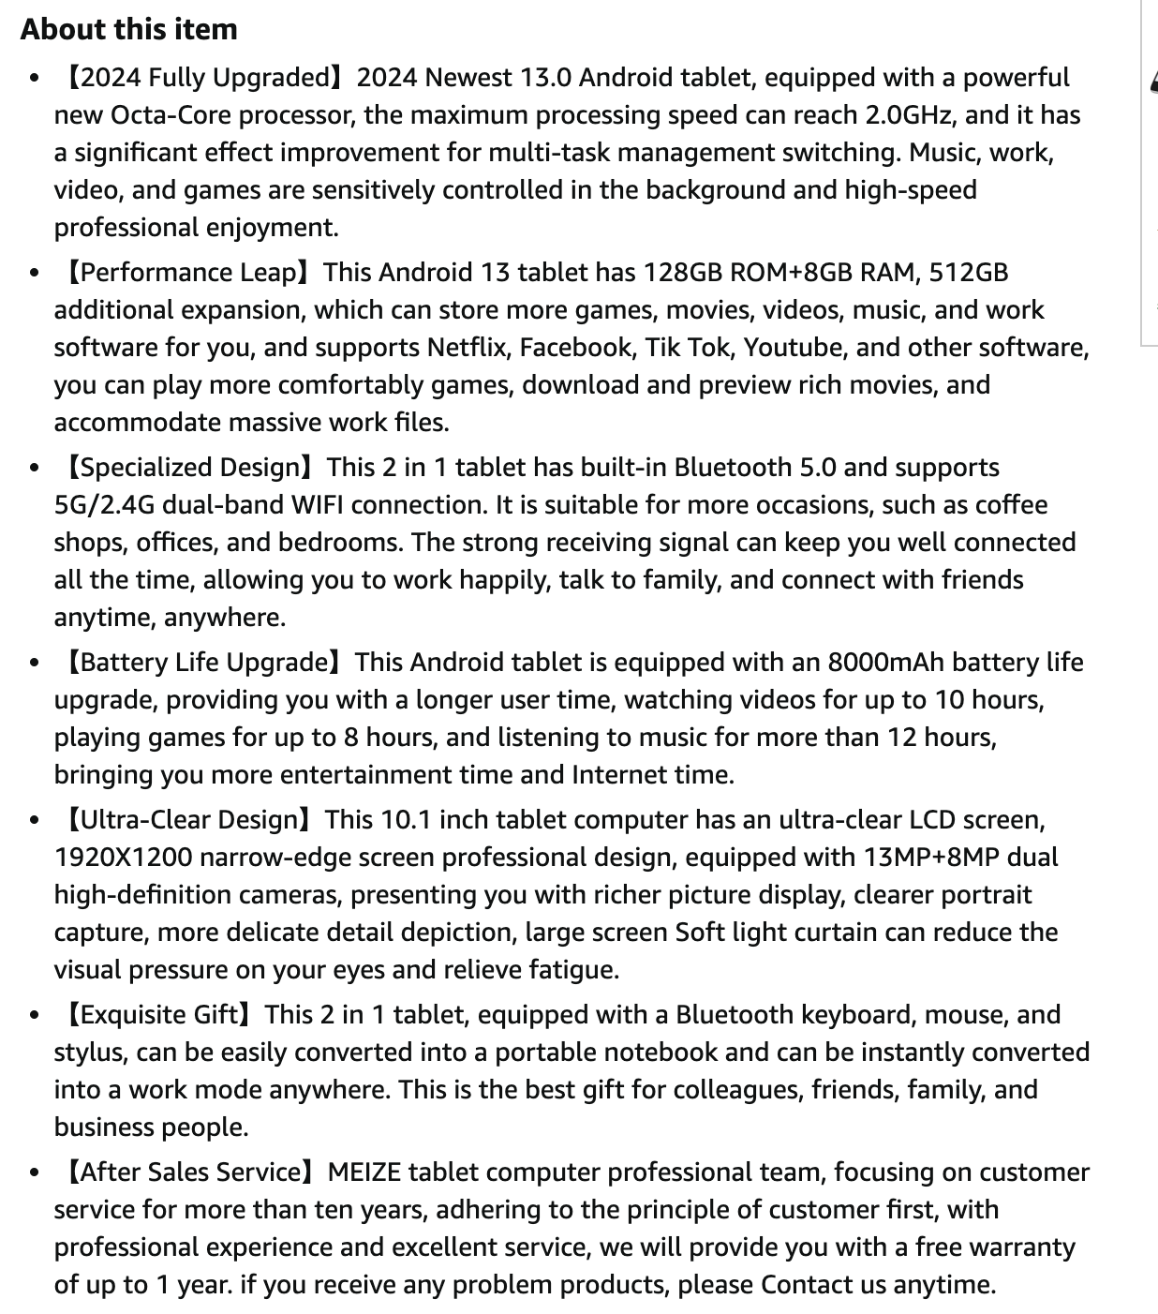
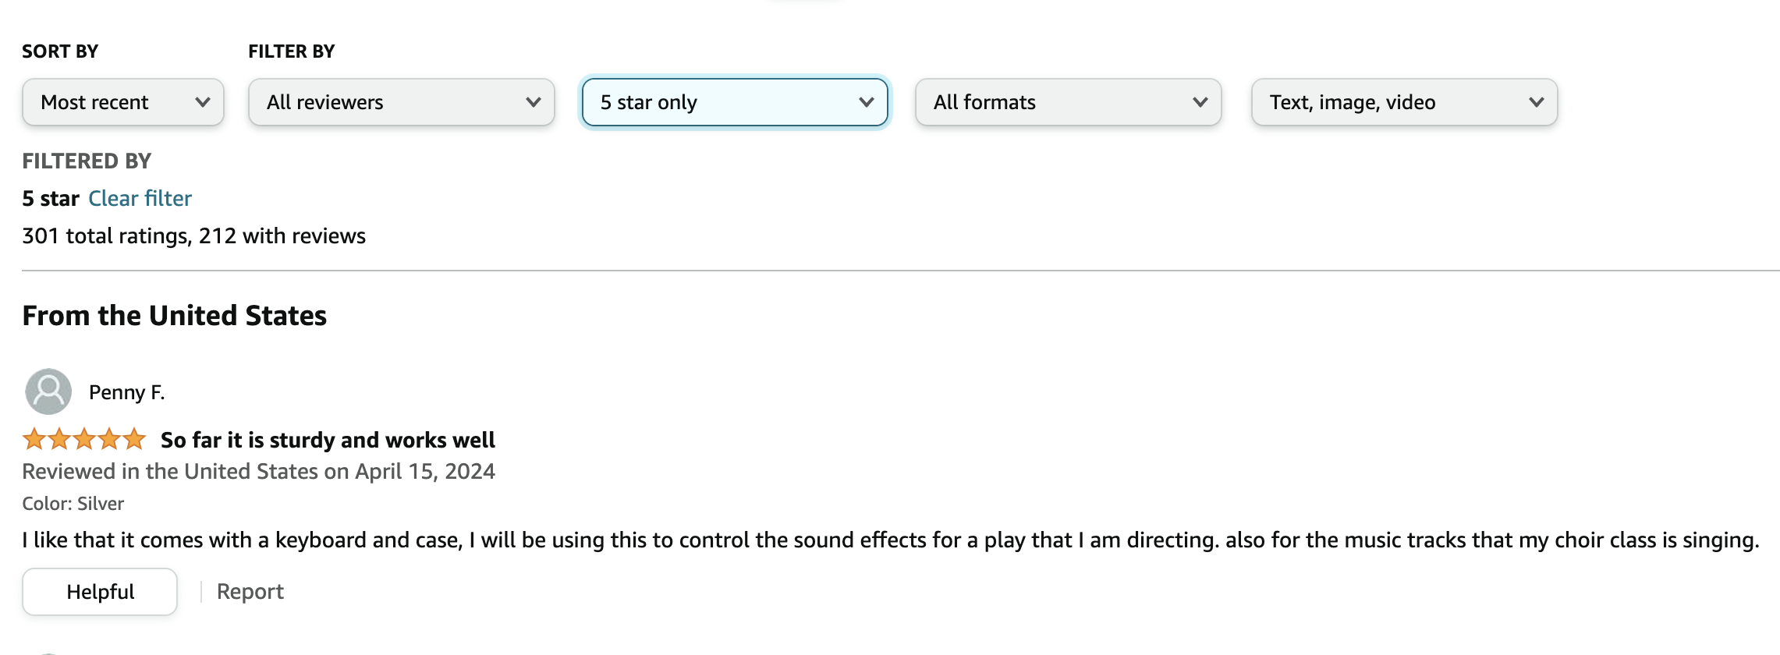

Product URL,
Product Tile, Overall rating, Price, Image URL, Description, Features of the Product
Star rating, Date, Title, Review of each review
Web scrapping
Stored in Database

Slide 13
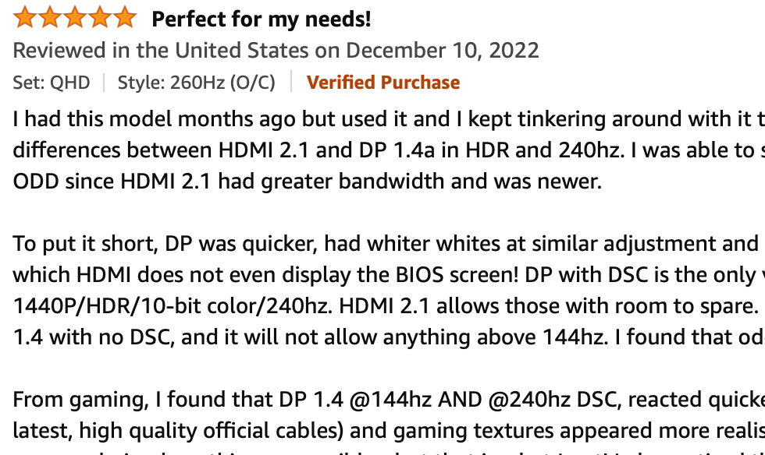
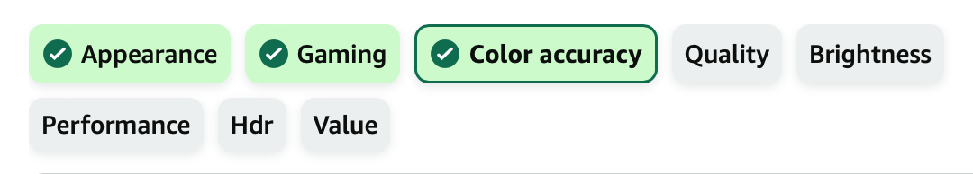
Feature Scoring and Sentiment Analysis
Zero-shot classification,
based on scraped features
Sentiment analysis
Positive(%95, Negative %5)

Slide 14
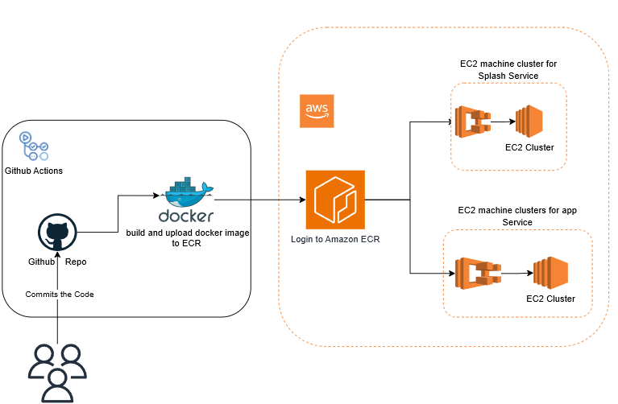
Architecture

Slide 15
Challenges & Issues encountered
Showing updates in real-time was needed, so we solved it using async-update model instead of traditional request-response model using Redis.
Multi-container deployment was needed as we were using splash as our page rendering microservice.
Latency problems exists as there were heavier processing involved. So, we incorporated both threading and concurrency using threading module and asyncio module thorough out all the steps.
Issues with word cloud package while building docker image(Instead created word cloud in js)
Limited Coverage and small dataset (500 reviews maximum) might lead to inadequate insights
Product should have features to get insights
Token size limitation in sentiment classification model. (512 characters)
Asynchronous scrapping limitation in Amazon leading to increased scrapping time

Slide 16
Demo
/

